Slide 1


Slide 2


Enfoque de fortalecimiento de capacidades de la OMMS para las Organizaciones Scouts Nacionales
Fortalecimiento de la Capacidad

Slide 3

¿Qué es el Enfoque de Fortalecimiento de la Capacidad de la OMMS?
Notes:
Vision 2023 – enabling 100 million young people to be active citizens creating positive change in their communities and in the world based on shared values.
Membership growth - To achieve membership growth it is not only important to have a quality scouting experience, but also a strong organizational foundation
Building capacity of NSOs around the world through the various support mechanisms in place,
1) connecting NSOs with other NSOs to share best practices
2) Understanding strengths and areas of improvement through assessment using GSAT
3) Aligning and innovating against international best practices
4) WOSM Services and support from World Scouting

Slide 4


Evaluación
GSAT se utiliza para evaluar fortalezas y áreas de mejora
Ayudar a la OSN a evaluar su capacidad actual
Monitoreo
Priorización
Ayudar a la OSN a monitorear los resultados y a contar su historia
Ciclo de Fortalecimiento de las Capacidades de la OMMS
Priorizar el Plan de Acción
Se crean planes de acción que garantizan la decisión y el establecimiento de prioridades.
La calidad de la entrega y el progreso son monitoreados en la Plataforma de Servicios de la OMS
Soporte
Los servicios de la OMMS son entregados en linea con el Plan de Acción
Ayudar a la OSN a identificar apoyo
Notes:
Assessing
Prioritizing
Supporting
Monitoring

Slide 5

Plan Trienal Mundial 2017-2020
Para el año 2020, el 75% de las OSN completarán una Evaluación GSAT.
Notes:
Good Governance
Continue the implementation and further development of Global Support Assessment Tool as WOSM’s standard for NSOs and ensure follow-up on its results.
By 2020, 75% of NSOs will complete a GSAT assessment.

Slide 6

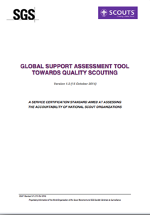
Estándar de Calidad del Movimiento Scout Mundial
Basado en los principios de Buena Gobernanza y Calidad del Movimiento Scout
Desarrollado en cooperación con SGS
Hecho a la medida para la OMMS
Notes:
GSAT is World Scouting’s stamp of quality for National Scout Organisations (NSOs), establishing standards of good governance and quality Scouting that mirror international best practice.
This tool was developed in cooperation with an external organisation, specialized in Certification of NGOs called SGS
And the tool is tailored for WOSM which means that is it was based on evaluation tools that already existed on the Regional Levels, such as the NSO Check List, the Route to Excellence in IAR and the CNV (Committee NSO Visit) in APR.

Slide 7






Objetivos
Medición de la Calidad
Una herramienta para el mejoramiento
Juntos tomando acción
Crecimiento de nuestro Movimiento
Compromiso con la Excelencia
Notes:
Benchmark - Measurement of quality - A cross-regional assessment tool that gives NSOs the opportunity to measure themselves against established global standards
Assessment - A tool for improvement - GSAT offers NSOs the ability to evaluate their own operations, and identify strengths and areas for improvement
Addressing priorities - Taking action together - Successful and efficient follow-up of assessments allows World Scouting to address the priorities, not only of NSOs, but also our Movement as a whole; guiding our actions for the future
Capacity strengthening - Growing our Movement - GSAT enables World Scouting to improve its support for NSOs, based on the needs and trends identified through the GSAT assessments, enhancing the capabilities of our Movement
Continuous improvement - Commitment to excellence - GSAT encourages the on-going development of our Movement to bring about purposeful change.

Slide 8














10
Dimensiones
Notes:
Our 10 GSAT Dimensions

Slide 9

96
Criterios GSAT
Objetivamente
Verificables
Criterio GSAT 608: Formación de los Adultos
La OSN tiene un marco claro de capacitación y desarrollo personal para adultos (personal profesional y voluntarios). Cada currículo de capacitación tiene objetivos claros, las competencias mínimas requeridas y se revisa periódicamente.

Slide 10
¿Cómo funciona?
Puntaje entre 0 y 3
Basado en Evidencias
15 Banderas Rojas
(No Conformidades Mayores)
5 Dimensiones Clave
  D02 – Marco de Gobernanza
  D03 – Marco Estratégica
  D06 – Adultos en el Movimiento Scout
  D07 – Asignación de Recursos y Controles Fiancieros
  D08 – Programa de Jóvenes

Slide 11

Métodos de Evaluación GSAT | Autoevaluación GSAT | Evaluación WOSM | Auditoría GSAT
Conducida por | Organización Scout Nacional | Evaluador de la OMMS | Auditor de SGS
Tiempo de Preparación | 1+ meses | 2+ semanas | 2+ semanas
Entrega | Virtual o en persona | En persona | En persona
Duración | De 2 días a 2 meses | 4 días | 4 días
Soporte | Facilitador GSAT Virtual | Facilitator GSAT Virtual o En persona | Facilitador GSAT En persona
Notes:
Three version using the same tool from Audit to Self-Assesment.
1. stepstone approach: this is a classic approach where the NSO first tries out the self-evaluation internally, then asks the Region to conduct a 2nd party assessment, and so ultimately going for the 3rd party. The added value in this approach is that the NSO gets time to become acquainted with GSAT and is adequately prepared for each step, resulting in a higher chance for eventual certification.
2- regionally guided apprach: in this approach the Region takes an active role in selecting which NSO is ready for a specific model, and then liaises directly. This also allows a Region to build a robust dataset of GSAT results which can be used to finetune their own support processes.
3. donor-driven approach: an NSO might be interested, due to the potential or willingness to attract new donors, to aim for certification. In such a case a 3rd party audit might be immediately opted for after recommendation by the Region.

Slide 12

¿Por qué hacer una autoevaluación GSAT?
Ayudar a definer su Plan Estratégico
Identificar áreas para fortalecer y mejorar
Fortalecer la capacidad a través de los Servicios de la OMS
Preparación o seguimiento de una Evaluación GSAT

Slide 13


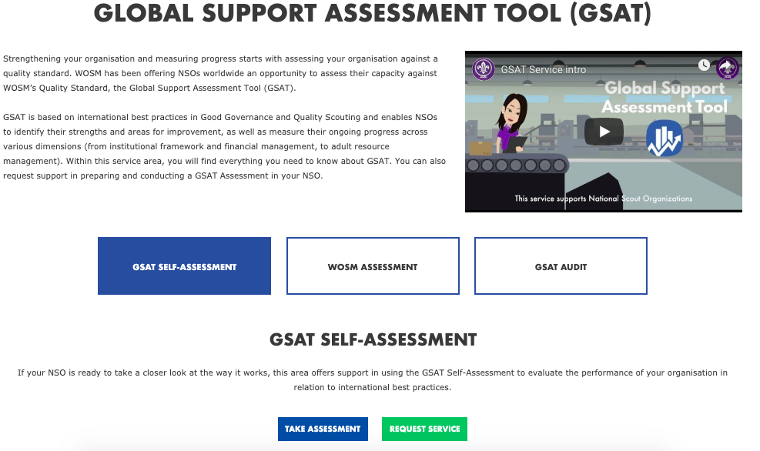
Solicitando un Servicio de GSAT
services.scout.org
Notes:
Can request on the WOSM Service Platform for support to do a GSAT Self-Assessment
A selection of consultants are trained around the world to support GSAT – trained to understand the tool and support NSOs in preparing for and undergoing an assessment
A consultant can be assigned to support either in-person or virtually depending on capacity building plans within the Region and budget availability
While NSOs are always encouraged to do a GSAT Self-Assessment and can use our Guidelines as a resource to complete themselves, we ask that they at least notify the Region that they are doing a GSAT Self-Assessment a then even share the results.
Results are kept confidential and only shared with specific staff or assigned consultants to support the NSO in strengthening their capacity.

Slide 14





Proceso Recomendado
Notes:
Guidelines available on the GSAT Service page
A flexible approach
By team
Bring everyone together
Do over time or over one weekend
Good to have the key people in charge of different areas be part of the discussion and scoring
Evidence, Evidence, Evidence

Slide 15
ESTADO | EXPLICACIÓN | PUNTAJE
NO CUMPLE | No existe evidencia alguna que la OSN haya hecho algo en este criterio | 0
DE ACUERDO CON ALGUNOS DE LOS PUNTOS | Existe evidencia que la OSN ha hecho algo (pero no todo) alrededor de este criterio | 1
DE ACUERDO CON LA MAYORÍA DE LOS PUNTOS | Existe evidencia que la OSN tiene muchas cosas alrededor de este criterio. Es actualizada e interpretada. | 2
CUMPLIMIENTO TOTAL | Existe evidencia de que la OSN tiene todo alrededor de este criterio. Es regularmente evaluado y actualizado. | 3
NO APLICA | No aplicable debido a las circunstancias locales o en relación con otro criterio no conforme | n/a
Notes:
Important to note that you do not pass or fail GSAT, you however gain an understanding in your strengths and areas for improvement and assess capacity and a way forward to strengthening that capacity
0=NO / 3=YES
Score 0: no evidence at all exists that the NSO has done anything around this criteria
Score 1: evidence exists that the NSO has done something in the past around this criteria
Score 2: evidence exists that the NSO has an up-to-date and implemented policy around this criteria
Score 3: evidence exists that the NSO has an up-to-date and implemented policy around this criteria, that is regularly evaluated and refreshed

Slide 16

Ejemplo de Puntuación
203: El “Consejo Nacional” y la “Asamblea General” toma decisiones por mayoría simple de los votos emitidos, excepto para cambios de la Constitución y disolución, los cuales requieren una mayoría cualificada.
Si no hay reglas | 0
Si hay una regla para tomar decisiones por mayoría simple. Constitución y Disolución no son mencionadas | 1
Si hay una regla para tomar decisiones por mayoría simple para todas las decisiones incluyendo cambios en la constitución y Disolución | 2
Si cumple con todos los criterios | 3

Slide 17

Servicio GSAT
services.scout.org/service/9
Notes:
Access all the resources for GSAT to learn more

Slide 18

¿Preguntas?

